Slide 1
Contraception/Pregnancies
MTN 020

Slide 2
Why do we care?
Participants must come off product during pregnancy and breastfeeding
Studies of dapivirine in pregnant animals suggest no harm
BUT, dapivirine has not been testing in human pregnancy
Time off product results in dilution of effect
If there really is a protective effect of study product, we may not be able to detect it because of time off product
Notes:
In rats some effects on the developing fetus were observed following oral administration at maternally toxic doses (80 to 320 mg/kg) of dapivirine. However, there were no effects in rats at the maternally non toxic dose of 20 mg/kg/day or in rabbits up to 90 mg/kg. No toxicity to maternal animals or the developing embryo/fetus was seen following vaginal dosing in embryo-fetal development studies in rats and rabbits. Vaginal reproductive toxicity trials in rats and rabbits using a formulation of dapivirine gel at nominal concentrations up to 3.3 mg/ml using a dose volume of 0.2 ml/kg and rabbits (up to 2 mg/mL using a dose volume of 1.0 mL)

Slide 3
ASPIRE Goal- Pregnancy Prevention
Prevent intentional pregnancies
Screening procedures
Prevent unintentional pregnancies
Offer contraceptive counseling
Providing effective contraception
Expand the contraceptive mix available to participants in ASPIRE

Slide 4
Contraceptive Counseling
Open conversations
Participant centered
Goal
Provide rationale for contraceptive requirement
dapivirine is an investigational product
Counsel on all available methods
Help ppt to choose the method that is best for her
Obtain accurate information about use

Slide 5
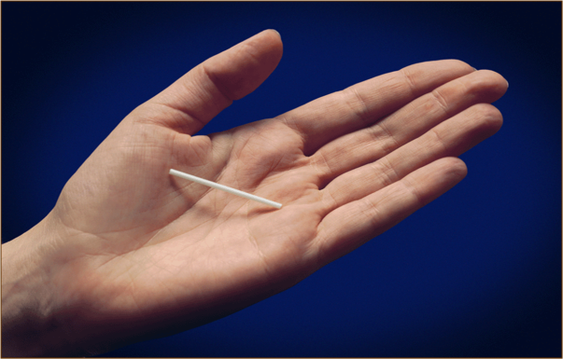
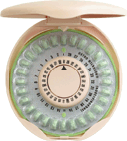
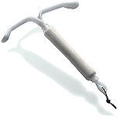
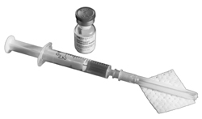
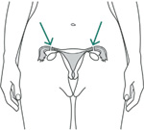
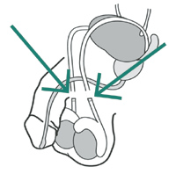
Expanding Methods Mix
Notes:
Ask site staff report on which of the various methods the site will be providing directly and which will be available only through referral. Sites are encouraged to provide as many methods as possible.
Image #1 = Combined OCP
Image #2 = Progestin only pill
Image #3 = Injectable (Depo and others)
Image #4 = Implant
Image #4 = Implant
Image #5 = IUCD
Image #6 = surgical sterilization
Some discussion regarding contraception action team- identify site representatives

Slide 6
Background and References
WHO Medical Eligibility Criteria for Contraceptive Use (with 2008 update)
Your contraceptive site experts
Princess and Nonzwakazi
Trisha and Clearance Thembekile
Family Planning: A Global Handbook for Providers (USAID/JHSPH/WHO)
Contraceptive Technology, 20th Edition

Slide 7
Screening
Protocol Section 5.2
Not pregnant
Using an effective method of contraception at enrollment
Hormonal method (except ring)
IUCD
Sterilization of participant (not partner)
Intending to use an effective method for the duration of study participation

Slide 8
Case 1
19 yo woman is interested in participating in MTN 020. She is sexually active with one stable male partner for the past six months.
She agrees to use some form of contraception
She currently uses male condoms “some of the time”

Slide 9
Case 1
Describe how you would counsel her.
Any concerns about starting BOTH a new method of contraception AND dapivirine ring? (side effects, adherence/joint adherence, etc.)
Notes:
First bullet: history of use, contraindications to a particular method (htn and ocp), partner/family expectations- client centered counseling
Second bullet: Some discussion regarding starting contraception early in the screening period (or prior to the screening period)
May also want to touch on her reporting of condom use some of the time. Recommended condom use for all participants, but especially those who choose to use depo as their contraceptive.

Slide 10
Choosing a Contraception
Did you know?
IUCD is a good option- even for women who have never had a baby?
OCP use is associated with the highest pregnancy rate of MTN 020 methods?
In some studies, DMPA is associated with a higher rate of HIV acquisition?
Ask your contraceptive expert for more information

Slide 11
Enrollment
Tracking contraceptive method is imperative
It starts at enrollment- Baseline Family Planning
Identifying baseline side effects is important
Baseline = enrollment visit
May impact contraception adherence
May impact product use adherence
May impact AE reporting in the future

Slide 12
Case 2
The same participant from Case 1 has opted for DMPA
She receives her first injection at screening
When she returns for her enrollment visit she reports intermittent spotting since her injection 3 weeks ago
Assess willingness to continue method
Address concerns; provide reassurance if applicable
Anticipate problems
Review options
Notes:
Always her perogative to stop a contraceptive method
Bleeding is a common side effect for depo.
This participant may not want to use a ring with bleeding or may confuse the bleeding with ring side effect. Proactively discuss whether she will be comfortable using the ring with the spotting. Reassure.
Options include- continue the method after reassurance and counseling, change methods, don’t enroll. (if opts for changing methods probably makes sense to reschedule enrollment visit if possible to allow some time on the method)

Slide 13
Case 2
What forms do you need to complete?
PRE-1
Update Menstrual History
Baseline Family Planning
Does this situation concern you?

Slide 14
Follow-Up
Tracking contraception use at every visit
Family Planning CRF
Contraceptive Counseling at every visit
Contraceptive work sheet template
Record sufficient information to review and follow-up at each visit
For methods dispensed at site, chart flags are recommended
Notes:
Content will necessarily vary
Record sufficient information and detail to support review and follow-up at each visit
Use chart notes, flow sheets, and/or other documentation tools
Chart flags/flyers are strongly recommended to highlight key dates (e.g., next injection)
Similar flags in pharmacy system can be very helpful

Slide 15
Case 3
A 23 year old woman presents for her Month 3 visit and tells you that she was married two weeks ago
She started oral contraceptive pills at the screening visit
The site receptionist overheard the participant telling another participant that she was looking forward to the pregnancy test because she and her new husband were hopeful for a child soon
How will you elicit truthful information from this participant?
What are your concerns?
How will you start this conversation?

Slide 16
Case 3
In fact, she has not been taking her oral contraceptive pills
What now?
Counseling messages
Study product implications
Study participation implications
Documentation
Notes:
Counseling messages- unknown effect of dapivirine on developing human fetus. Theoretical risk is exceptionally small- but unknown
Continue product
Document on family planning crf- NO contraception

Slide 17
Pregnancy
Protocol Section 7.5.2
Continue all protocol specified procedures except
Provision of vaginal ring
Product use instructions
Adherence counseling*
Retention check-in will continue with pregnancy (Step 6 of ACE Program)
Pelvic exams, including vaginal fluid collection, after 24 weeks
Both pelvic and self swab collection are optional after 24 weeks. They are safe and should be encouraged.
Contraceptive counseling
Offer enrollment into MTN 016
Notes:
Note that as a part of ‘adherence counseling’ the retention check-in (Step 6 or 7 in the ACE approach) will continue when there is a pregnancy.

Slide 18
Case 4
27 year old woman on oral contraceptive pills presents for her month 6 visit with some nausea/vomiting x 2 weeks
Urine pregnancy test is positive
What will you do and how will you document?
Monthly Lab Results CRF
Pregnancy Report CRF
Conmed CRF (contraception stopped)
Product hold CRF
Vaginal Ring Request Slip

Slide 19
Case 4
She presents 2 weeks later for an interim visit with scant vaginal bleeding and cramping
Has an AE occurred?
SSP Section 11.3.3
She returns two weeks later and reports that she had a miscarriage soon after leaving the clinic last visit

Slide 20
Case 4
Next steps?
Confirm status of pregnancy versus loss
Complete pregnancy outcomes form
When can product be resumed?
Protocol Section 7.5.2
Negative pregnancy test
Not breastfeeding
Absence of findings on pelvic exam that would contraindicate resumption

Slide 21
Big Picture
Time off product limits our ability to detect the ring’s protective effect, if it exists
Minimize intended pregnancies by careful screening procedures
Minimize unintended pregnancies by providing relevant counseling and appropriate methods

Slide 22
Big Picture (2)
Maximize product adherence by addressing side effects of both contraceptive method and study product
Elicit truthful contraceptive use
When in doubt, ask your experts…..

